Slide 1
LECTURE – 5
Introduction to DEEP LEARNING

Slide 2

HUMAN BRAIN
Left Analytic Part and Right Holistic Part
EXPERIENCE = ANALYTIC/USABILITY + CREATIVE/DESIGNS

Slide 3
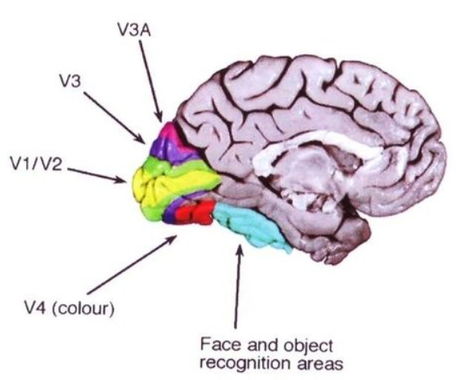
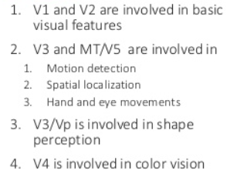
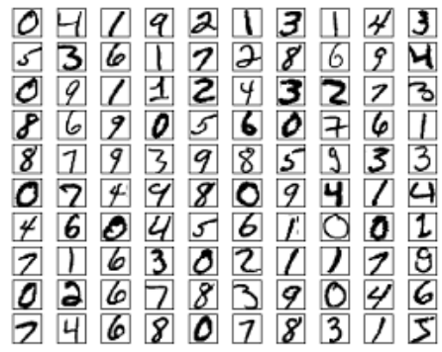
HUMAN BRAIN – Visual Cortex
HOW BRAIN FUNCTIONS ON BASIS OF NEURONS:
V1 = visual cortex, containing 140 million neurons,
with tens of billions of connections between them.

Slide 4
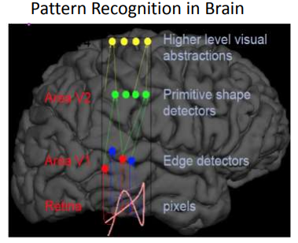
HUMAN BRAIN – Neural Net.
HOW BRAIN FUNCTIONS ON BASIS OF NEURONS:
V1 = visual cortex, containing 140 million neurons,
with tens of billions of connections between them.

Slide 5
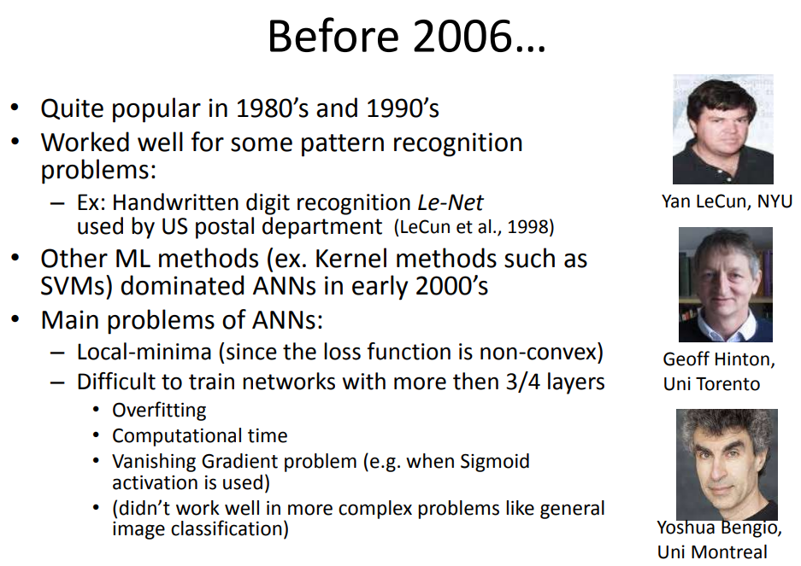

Slide 6
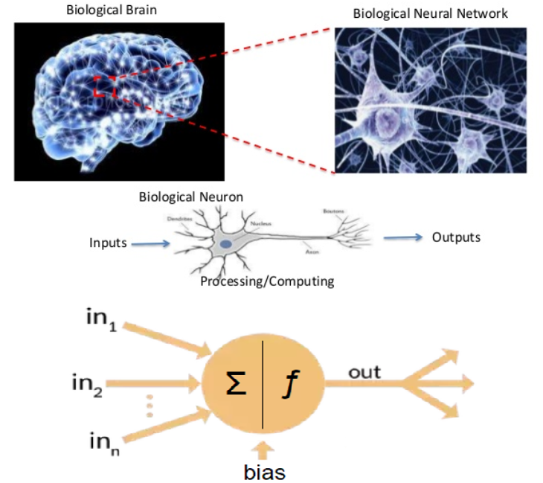
BRAIN NEURON NEURAL NET ARTIFICIAL NEURON

Slide 7
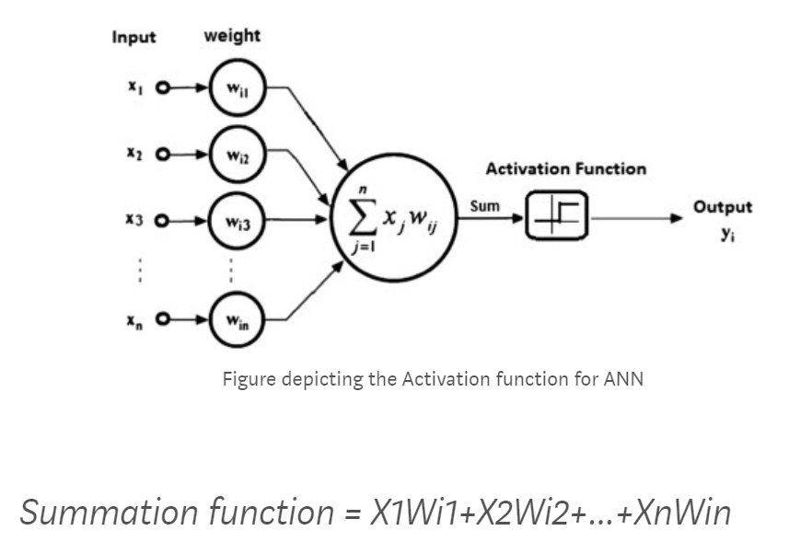
ANN – “PRECEPTRON”

Slide 8
ANN - PERCEPTRON

Slide 9
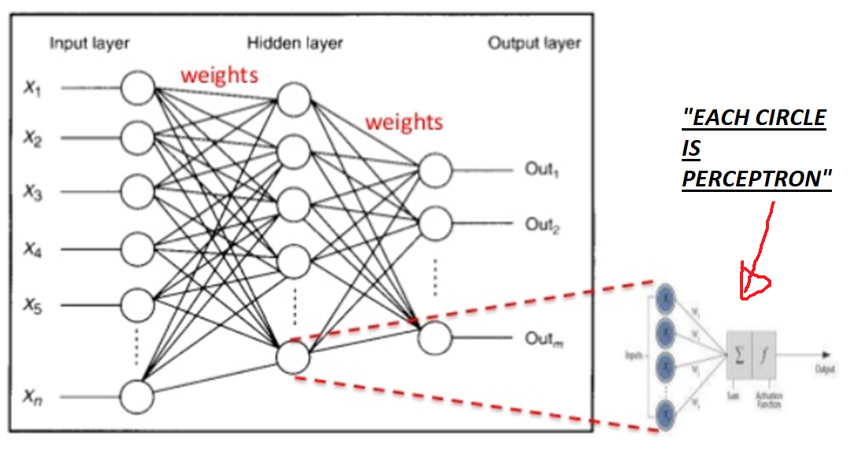
MLP- MULTI LAYRE PERCEPTRON

Slide 10
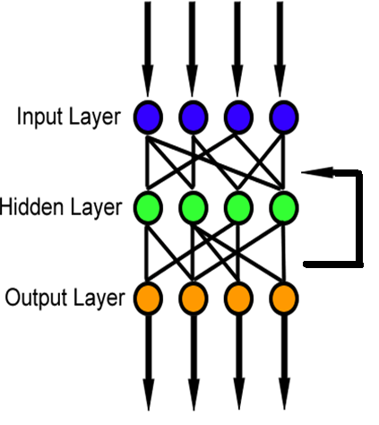
MLP – Learning Process
Learning happens in two steps:
Forward-Propagation
is making a guess about the answer
Back-Propagation
minimizing the error between the actual ans. and guessed ans.

Slide 11
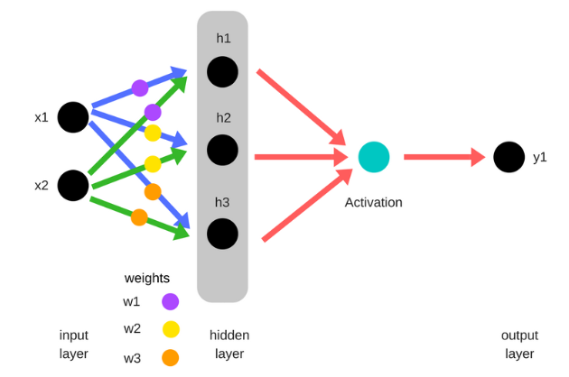
Forward (Guess)
Data at input layer is multiplied with weights to form hidden layer
h1 = (x1 * w1) + (x2 * w1)
h2 = (x1 * w2) + (x2 * w2)
h3 = (x1 * w3) + (x2 * w3)
Output of hidden layer is passed through a non-linear function also known as activation function to form guessed output
y_ = f( h1 , h2, h3 )

Slide 12
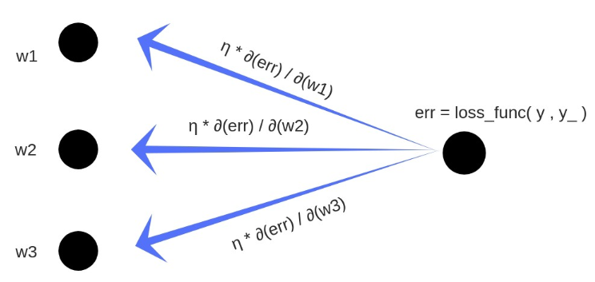
Backward (Min Error)
1. Total error is calculated by calculating the difference between the expected value ‘y’ (value in training set) and observed value ‘y_’ (value attained from forward propagation) by passing them through a cost function.
2. Partial derivative of error is calculated w.r.t each weight ( these partial differentials are measures of contribution of each weight in total loss
3. The differentials are then multiplied by a small number called learning rate ( η )
4. The resultant is then subtracted from the respective weights
w1 = w1 - (η * ∂(err) / ∂(w1))
w2 = w2 - (η * ∂(err) / ∂(w2))
w3 = w3 - (η * ∂(err) / ∂(w3))

Slide 13
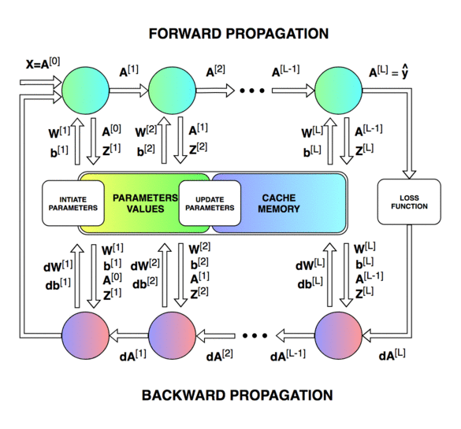

Slide 14
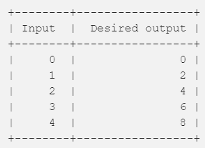
Backward (EXAMPLE)
output = 2 x input
(Model 1): y=3.x [LETS CHECK THIS]
(Model 2): y=5.x
(Model 3): y=0,5.x.
IDEAL solution (y=2.x)

Slide 15
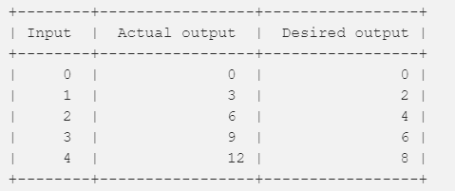
Backward (EXAMPLE)
output = 2 x input
(Model 1): y=3.x
Desired Output VS Actual Output

Slide 16
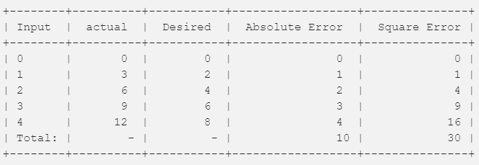
Backward (EXAMPLE)
loss = Absolute value of (desired — actual )
sum of squares of the absolute errors
(RSME) – ROOT MEAN SQUARE ERROR

Slide 17
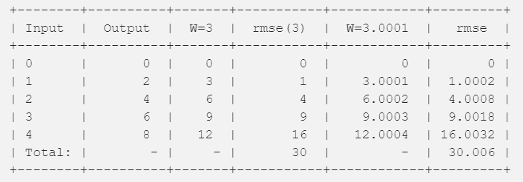
CHECK Increase :
increase W from 3 to 3.0001- RMSE also increased
little bit more error
What about DECREASE W from 3 towards 2 (2.9, 2.8, … 2.5, … 2.1, 2.0)
NOW WE REASCH TO IDEAL Equation - y=2.0 X
(The only Reason is Forward and Backward Propagations in MLP)

Slide 18
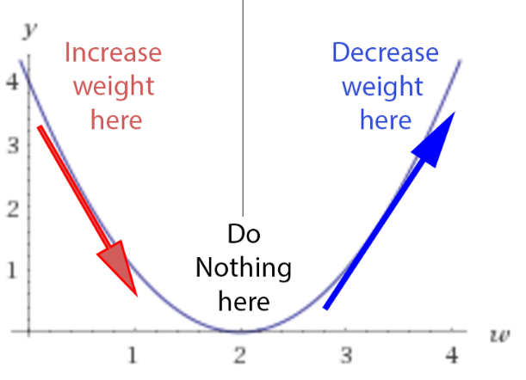
WEIGHTS – LEARNING PROCESS
The learning process is:
Let’s check the derivative.
- If it is +VE, meaning the error increases if we increase the weights, then we should decrease the weight.
If it’s –VE , meaning the error decreases if we increase the weights, then we should increase the weight.
- If it’s 0, we do nothing, we reach our stable point.
https://mattmazur.com/2015/03/17/a-step-by-step-backpropagation-example/

Slide 19
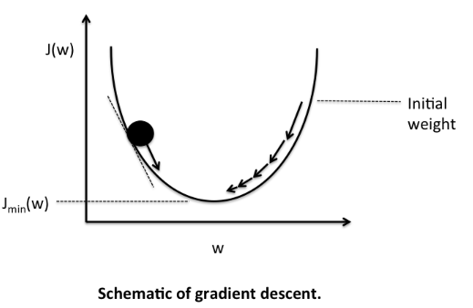
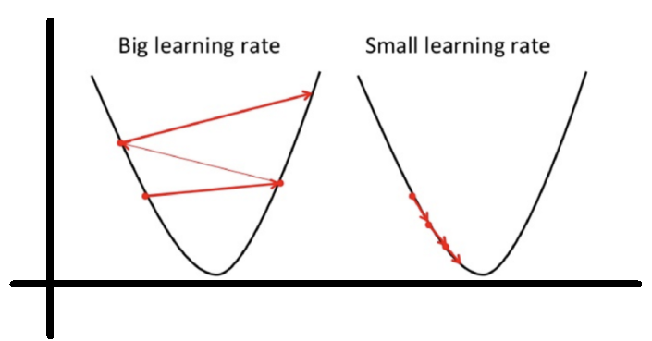
GRADIENT DESCCENT
LEARNING RATES

Slide 20
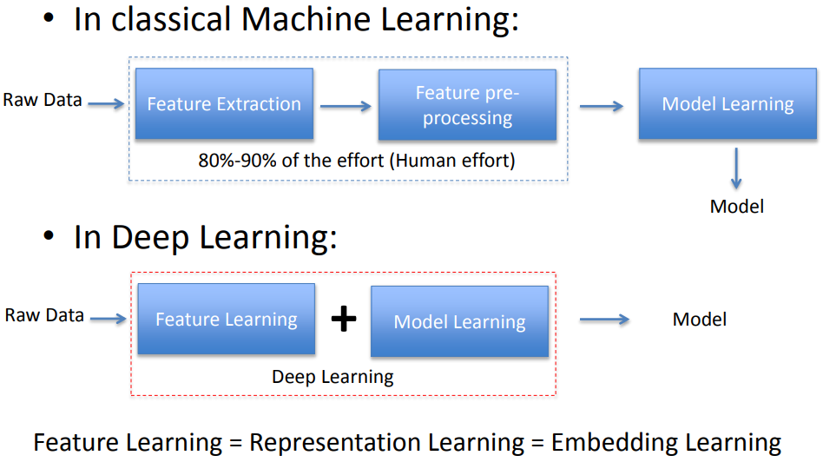
ML VS DL

Slide 21
KERAS

Slide 22
ML VS DL

Slide 23
ML VS DL

Slide 24
ML VS DL

